Slide 1
Magnets for Sarcasm: Making Sarcasm Detection Timely, Contextual and Very Personal
Proceedings of the 2017
Conference on Empirical Methods in Natural Language Processing, pages 482–491 Copenhagen, Denmark, September 7–11, 2017. c 2017 Association for Computational Linguistics
Presenter: WUHAO December 17, 2018

Slide 2
Outline
Introduction
Related work
Dataset Construction
Method
Experiments
Conclusions
SWOT

Slide 3
Introduction
Sacarsm:什麼是 By combining an overtly positive attitude with a meaning that is more deserving of scorn, sarcasm allows speakers to communicate disappointment
通過將一種明顯積極的態度與更值得鄙視的意義相結合，諷刺讓發言者能夠表達失望之情
PHOTO
Condition:雙方都有時下知識
Notes:
諷刺是社交媒體中普遍存在的現象
對話性 和直述性的

Slide 4
Introduction
Kreuz and Glucksberg, 1989
Utsumi，2000b
sarcasm is highly dependent not just on the context of an utterance but on the state-of-mind and personality of the speaker, as well as on facial expressions and prosody
Photo 沒有上下文，情緒很差的時候
Notes:
目前這些著作，尚未轉化為我們nlP的文本分析方法，
他不止和背景知識有關，還和情緒 個性 表情 平仄有關
在製作時洞察演講者的心理狀況是諷刺檢測背景的重要來源

Slide 5
Introduction
Personality：
mood – which is changeable – is perhaps just as useful if sampled in a timely fashion
Like:climate and weather
nlp 獲得情緒可以
personality需要長期對一個人的言行舉止，進行分析
所以本paper會對sacarsm的另外兩個重要因素進行分析

Slide 6

Related work
Campbell and Katz, 2012 ：lexical cues
so beautiful
so beautiful!!!! Very beautiful!!!
so beautiful
so beautiful#sacarsm #not

Slide 7
Related work
N-gram+ topic model
SVM 。。。（machine learning）
Deep learning
Notes:
N-gram+ topic model

Slide 8
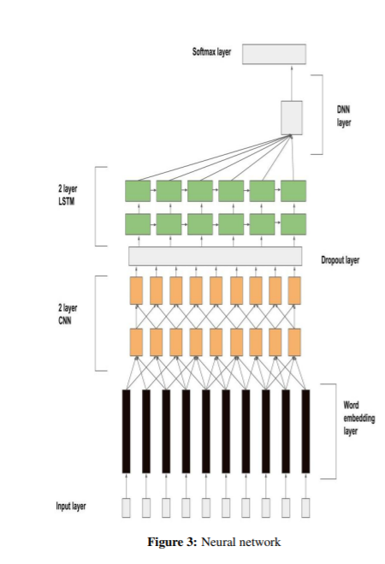
Related work
Baseline: 2016 NAACL

Slide 9
Dataset Construction

Slide 11
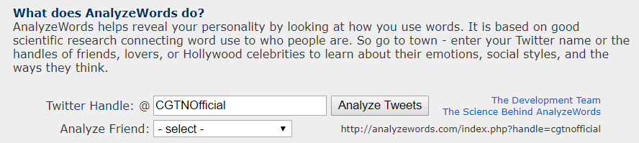
Method
http://analyzewords.com/index.php

Slide 12
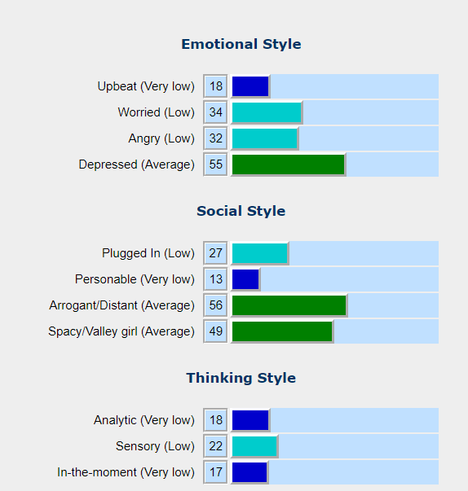
Method

Slide 13
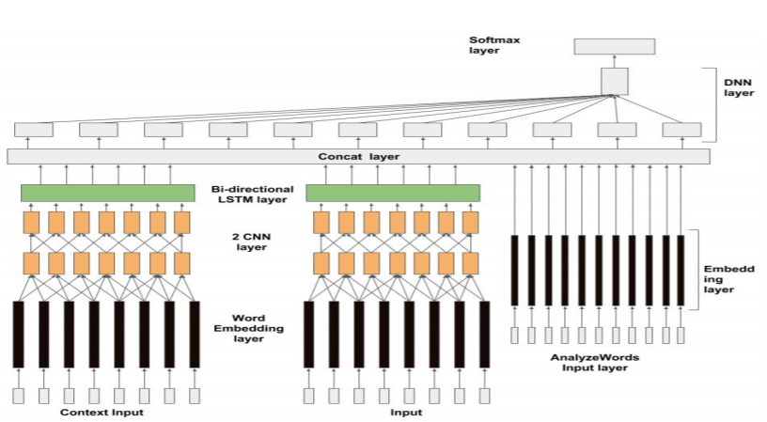

Slide 18
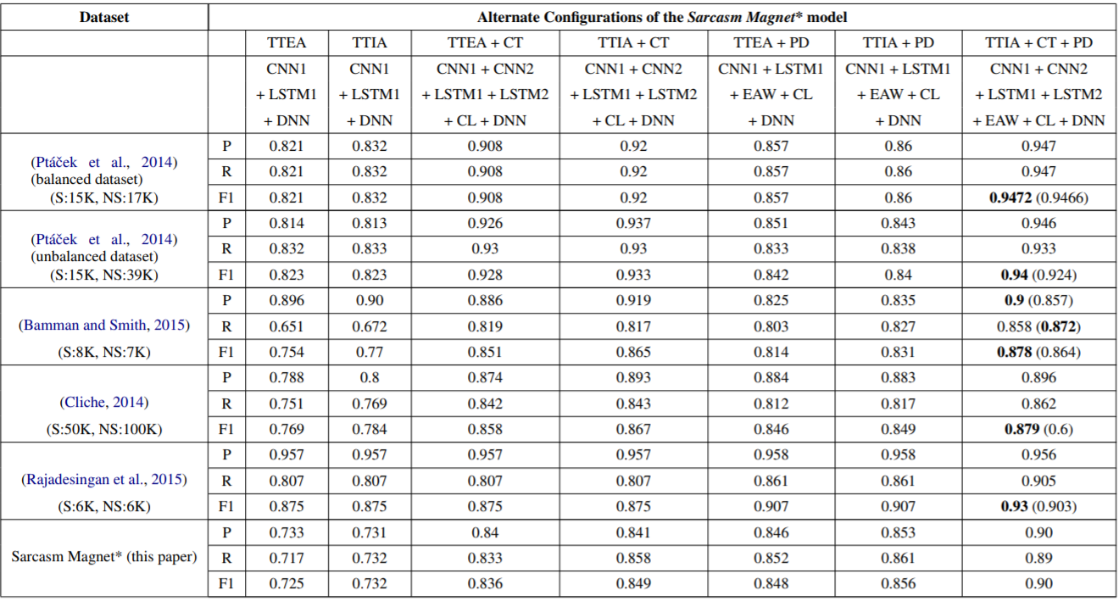

Slide 19
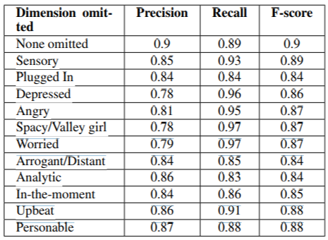
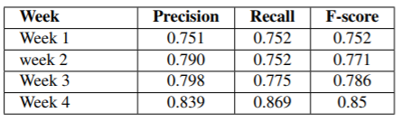

Slide 22
SWOT
Strengths
Weakness
Opportunities
Threats
Notes:
優勢的話，前面有一隻提到，使用cnn加gated ，不但可以並行化加速，還可以緩解梯度消失，抓住遠程有用的feature
weekness :cnn都知道參數很多，參數要tune很累，做一次的實驗需要2個禮拜，真的太久。
Opportunity 這是做sequence to one word 可以 接sequence to sequence 。後面的實驗可以嘗試做不同activation來對比swish說補丁有更好的結果
threats：要控制

Slide 23
QA

Slide 24
QA

